Slide 1
Scalar Encoder with Buckets
Presented by:
Aqib Javed Matriculation No. # 1427145
Haris Abbas Qureshi Matriculation No. # 1426968
Saad Jamil Matriculation No. # 1427200

Slide 2
Introduction:
Scalar value encoding is a fundamental operation in machine learning, used in a wide range of applications.
The technique involves HTM, SDR, Encoder and Scaler Encoder.
The encoding with bucket method is a significant improvement over traditional scalar encoding methods, providing increased accuracy and flexibility for a wide range of machine learning tasks.

Slide 3
Hierarchical Temporal Memory HTM:
It is used to model the structure and function of the neocortex, the part of the brain responsible for perception, learning, and intelligent behavior.
HTM can be used in various applications such as anomaly detection, natural language processing, and image recognition.
HTM can also be used in image recognition, where it can learn the features and patterns of images and recognize them in real-time.
Example of HTM application is in natural language processing. HTM can be used to model the structure and function of the language regions of the human brain and help to understand the context and meaning of natural language.
SDR:
SDR is often used in anomaly detection tasks because it can represent patterns of data in a way that is both sparse and distributed.
SDR can be used to represent the meaning of words and phrases in a way that is both efficient and effective.
SDR can be used in brain-computer interface systems to decode neural signals and convert them into actionable information.
Example of SDR is its use in natural language processing. In this application, each word is represented by an SDR, which allows for efficient and robust computation of the word's meaning.

Slide 4
Encoder:
Encoders are used to convert raw input data into Sparse Distributed Representations (SDRs).
It can be used to compress data by transforming high-dimensional data into a lower-dimensional representation while retaining most of the original information.
Encoders can be used in combination with decoders to create generative models that can generate new samples from the learned latent space.
Example of an encoder is the auto-encoder, which is a neural network architecture that is used for data compression and feature extraction.
Scalar Encoder:
Scalar encoder can be used to encode continuous time-series data, such as temperature or stock prices, into a sparse distributed representation (SDR).
Scalar encoder can be used to encode numerical data in natural language processing applications, such as sentiment analysis and text classification.
Scalar encoder can be used to encode sensor data from IoT devices, such as temperature, humidity, and light levels, into a sparse distributed representation.

Slide 5
Unit Tests I Scalar Encoder With Bucket Month of Year
public void ScalarEncoderWithBucketMonthOfYear(double input, double bucket, int[] expectedResult)
{
string outFolder = nameof(ScalarEncodingExperiment);
Directory.CreateDirectory(outFolder);
DateTime now = DateTime.Now;
ScalarEncoder encoder = new ScalarEncoder(new Dictionary<string, object>()
{
{ "W", 3},
{ "N", 14},
{ "MinVal", (double)0}, // Min value = (0).
{ "MaxVal", (double)11}, // Max value = (11).
{ "Periodic", false},
{ "Name", " Month of the Year"},
{ "ClipInput", true},
});
{ var result = encoder.Encode(input);
int? bucketIndex = encoder.GetBucketIndex(input);
int[,] twoDimenArray = ArrayUtils.Make2DArray<int>(result, (int)Math.Sqrt(result.Length),
(int)Math.Sqrt(result.Length));
var twoDimArray = ArrayUtils.Transpose(twoDimenArray);

Slide 6
Unit Tests I Scalar Encoder With Bucket Month of Year
Input Data Row
[DataRow(0, 0, new int[] { 1, 1, 1, 0, 0, 0, 0, 0, 0, 0, 0, 0, 0, 0, })] // To represent Jan.
[DataRow(1, 1, new int[] { 0, 1, 1, 1, 0, 0, 0, 0, 0, 0, 0, 0, 0, 0, })] // To represent Feb.
[DataRow(2, 2, new int[] { 0, 0, 1, 1, 1, 0, 0, 0, 0, 0, 0, 0, 0, 0, })] // To represent Mar.
[DataRow(3, 3, new int[] { 0, 0, 0, 1, 1, 1, 0, 0, 0, 0, 0, 0, 0, 0, })] // To represent Apr.
[DataRow(4, 4, new int[] { 0, 0, 0, 0, 1, 1, 1, 0, 0, 0, 0, 0, 0, 0, })] // To represent May.
[DataRow(5, 5, new int[] { 0, 0, 0, 0, 0, 1, 1, 1, 0, 0, 0, 0, 0, 0, })] // To represent June.
[DataRow(6, 6, new int[] { 0, 0, 0, 0, 0, 0, 1, 1, 1, 0, 0, 0, 0, 0, })] // To represent July.
[DataRow(7, 7, new int[] { 0, 0, 0, 0, 0, 0, 0, 1, 1, 1, 0, 0, 0, 0, })] // To represent Aug.
[DataRow(8, 8, new int[] { 0, 0, 0, 0, 0, 0, 0, 0, 1, 1, 1, 0, 0, 0, })] // To represent Sep.
[DataRow(9, 9, new int[] { 0, 0, 0, 0, 0, 0, 0, 0, 0, 1, 1, 1, 0, 0, })] // To represent Oct.
[DataRow(10, 10, new int[] { 0, 0, 0, 0, 0, 0, 0, 0, 0, 0, 1, 1, 1, 0, })] // To represent Nov.
[DataRow(11, 11, new int[] { 0, 0, 0, 0, 0, 0, 0, 0, 0, 0, 0, 1, 1, 1, })] // To represent Dec.
.

Slide 7
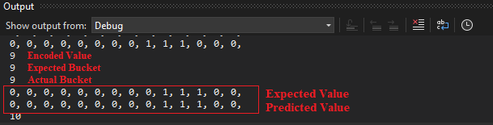
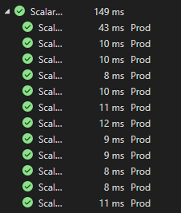
Output & Result
For Value =9, W=3, N=14, MinVal=0, MaxVal =4 , Periodic =False , ClipInput = True
Expected Bucket perfectly matched with Actual Bucket
Expected SDR perfectly matched with Actual SDR
Test Passed.

Slide 8
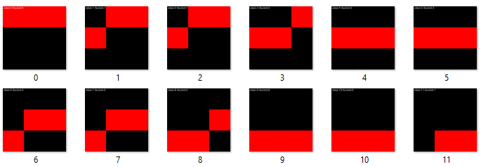
Output & Result
Bitmaps for all DataRows after setting all the parameter values and executing the Unit Test.

Slide 9
Unit Tests II Scalar Encoder With Bucket Bus Schedule
public void ScalarEncoderWithBucketBusSchedule(double input, double bucket, int[] expectedResult)
{
string outFolder = nameof(ScalarEncodingExperiment);
Directory.CreateDirectory(outFolder);
DateTime now = DateTime.Now;
ScalarEncoder encoder = new ScalarEncoder(new Dictionary<string, object>()
{
{ "W", 11},
{ "N", 24},
{ "MinVal", (double)0}, // Min value = (0).
{ "MaxVal", (double)1440}, // Max value = (1440).
{ "Periodic", false},
{ "Name", " Month of the Year"},
{ "ClipInput", true},
});
{ var result = encoder.Encode(input);
int? bucketIndex = encoder.GetBucketIndex(input);
int[,] twoDimenArray = ArrayUtils.Make2DArray<int>(result, (int)Math.Sqrt(result.Length),
(int)Math.Sqrt(result.Length));
var twoDimArray = ArrayUtils.Transpose(twoDimenArray);

Slide 10
Unit Tests II Scalar Encoder With Bucket Month of Year
Input Data Row
[DataRow(40, -5.0, new int[] { 1, 1, 1, 1, 1, 1, 0, 0, 0, 0, 0, 0, 0, 0, 0, 0, 0, 0, 0, 1, 1, 1, 1, 1, })]
[DataRow(155, -3.0, new int[] { 1, 1, 1, 1, 1, 1, 1, 1, 0, 0, 0, 0, 0, 0, 0, 0, 0, 0, 0, 0, 0, 1, 1, 1, })]
[DataRow(300, 0.0, new int[] { 1, 1, 1, 1, 1, 1, 1, 1, 1, 1, 1, 0, 0, 0, 0, 0, 0, 0, 0, 0, 0, 0, 0, 0, })]
[DataRow(422, 2.0, new int[] { 0, 0, 1, 1, 1, 1, 1, 1, 1, 1, 1, 1, 1, 0, 0, 0, 0, 0, 0, 0, 0, 0, 0, 0, })]
[DataRow(670, 6.0, new int[] { 0, 0, 0, 0, 0, 0, 1, 1, 1, 1, 1, 1, 1, 1, 1, 1, 1, 0, 0, 0, 0, 0, 0, 0, })]
[DataRow(700, 6.0, new int[] { 0, 0, 0, 0, 0, 0, 1, 1, 1, 1, 1, 1, 1, 1, 1, 1, 1, 0, 0, 0, 0, 0, 0, 0, })]
[DataRow(889, 9.0, new int[] { 0, 0, 0, 0, 0, 0, 0, 0, 0, 1, 1, 1, 1, 1, 1, 1, 1, 1, 1, 1, 0, 0, 0, 0, })]
[DataRow(900, 10.0, new int[] { 0, 0, 0, 0, 0, 0, 0, 0, 0, 0, 1, 1, 1, 1, 1, 1, 1, 1, 1, 1, 1, 0, 0, 0, })]
[DataRow(969, 11.0, new int[] { 0, 0, 0, 0, 0, 0, 0, 0, 0, 0, 0, 1, 1, 1, 1, 1, 1, 1, 1, 1, 1, 1, 0, 0, })]
[DataRow(1000, 11.0, new int[] { 0, 0, 0, 0, 0, 0, 0, 0, 0, 0, 0, 1, 1, 1, 1, 1, 1, 1, 1, 1, 1, 1, 0, 0, })]
[DataRow(1139, 13.0, new int[] { 0, 0, 0, 0, 0, 0, 0, 0, 0, 0, 0, 0, 0, 1, 1, 1, 1, 1, 1, 1, 1, 1, 1, 1, })]
[DataRow(1200, 15.0, new int[] { 1, 1, 0, 0, 0, 0, 0, 0, 0, 0, 0, 0, 0, 0, 0, 1, 1, 1, 1, 1, 1, 1, 1, 1, })]
[DataRow(1350, 17.0, new int[] { 1, 1, 1, 1, 0, 0, 0, 0, 0, 0, 0, 0, 0, 0, 0, 0, 0, 1, 1, 1, 1, 1, 1, 1, })]
[DataRow(1400, 18.0, new int[] { 1, 1, 1, 1, 1, 0, 0, 0, 0, 0, 0, 0, 0, 0, 0, 0, 0, 0, 1, 1, 1, 1, 1, 1, })]

Slide 11
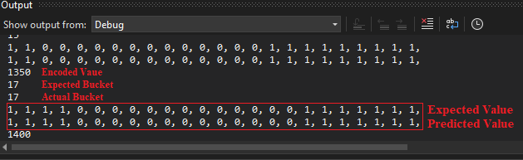
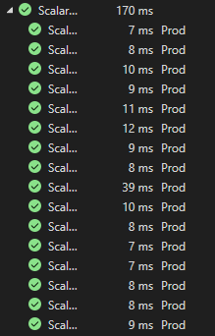
Output & Result
For Value =1350, W=11, N=24, MinVal=0, MaxVal =1440 , Periodic =False , ClipInput = True
Expected Bucket perfectly matched with Actual Bucket
Expected SDR perfectly matched with Actual SDR
Test Passed.

Slide 12
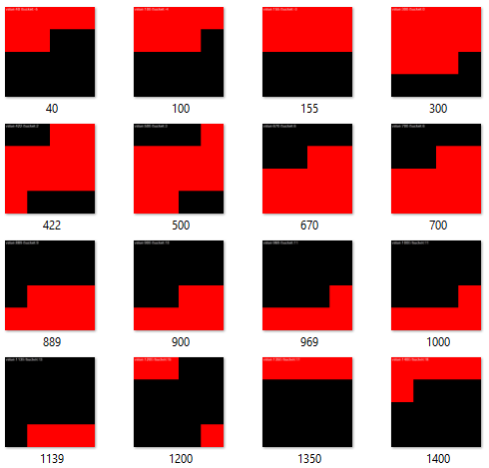
Output & Result
Bitmaps for all DataRows after setting all the parameter values and executing the Unit Test.

Slide 13
Unit Tests III Scalar Encoder With Bucket Ticket Number
public void ScalarEncoderWithBucketTicketNumber(double input, double bucket, int[] expectedResult)
{
string outFolder = nameof(ScalarEncodingExperiment);
Directory.CreateDirectory(outFolder);
DateTime now = DateTime.Now;
ScalarEncoder encoder = new ScalarEncoder(new Dictionary<string, object>()
{
{ "W", 11},
{ "N", 21},
{ "MinVal", (double)0}, // Min value = (0).
{ "MaxVal", (double)100}, // Max value = (100).
{ "Periodic", false},
{ "Name", " Month of the Year"},
{ "ClipInput", true},
});
{ var result = encoder.Encode(input);
int? bucketIndex = encoder.GetBucketIndex(input);
int[,] twoDimenArray = ArrayUtils.Make2DArray<int>(result, (int)Math.Sqrt(result.Length),
(int)Math.Sqrt(result.Length));
var twoDimArray = ArrayUtils.Transpose(twoDimenArray);

Slide 14
Unit Tests III Scalar Encoder With Bucket Ticket Number
Input Data Row
[DataRow(2.0, 0.0, new int[] { 1, 1, 1, 1, 1, 1, 1, 1, 1, 1, 1, 0, 0, 0, 0, 0, 0, 0, 0, 0, 0, })]
[DataRow(7.0, 1.0, new int[] { 0, 1, 1, 1, 1, 1, 1, 1, 1, 1, 1, 1, 0, 0, 0, 0, 0, 0, 0, 0, 0, })]
[DataRow(34.0, 3.0, new int[] { 0, 0, 0, 1, 1, 1, 1, 1, 1, 1, 1, 1, 1, 1, 0, 0, 0, 0, 0, 0, 0, })]
[DataRow(57.0, 6.0, new int[] { 0, 0, 0, 0, 0, 0, 1, 1, 1, 1, 1, 1, 1, 1, 1, 1, 1, 0, 0, 0, 0, })]
[DataRow(78.0, 8.0, new int[] { 0, 0, 0, 0, 0, 0, 0, 0, 1, 1, 1, 1, 1, 1, 1, 1, 1, 1, 1, 0, 0, })]
[DataRow(85.0, 9.0, new int[] { 0, 0, 0, 0, 0, 0, 0, 0, 0, 1, 1, 1, 1, 1, 1, 1, 1, 1, 1, 1, 0, })]
[DataRow(96.0, 10.0, new int[] { 0, 0, 0, 0, 0, 0, 0, 0, 0, 0, 1, 1, 1, 1, 1, 1, 1, 1, 1, 1, 1, })]

Slide 15
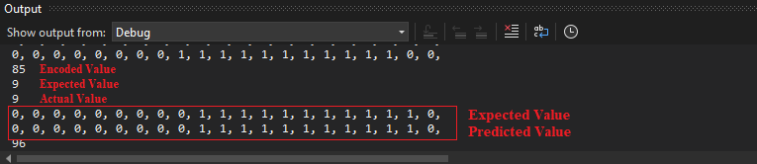
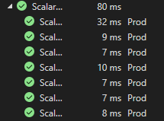
Output & Result
For Value =85, W=11, N=21, MinVal=0, MaxVal =100 , Periodic =False , ClipInput = True
Expected Bucket perfectly matched with Actual Bucket
Expected SDR perfectly matched with Actual SDR
Test Passed.

Slide 16
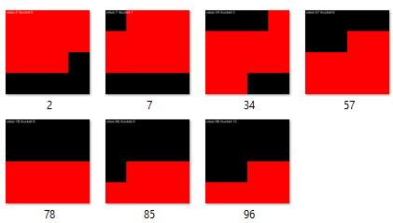
Output & Result
Bitmaps for all DataRows after setting all the parameter values and executing the Unit Test.

Slide 17
Unit Tests IV Scalar Encoder With Bucket Age Categories
public void ScalarEncoderWithBucketAgeCategories(double input, double bucket, int[] expectedResult)
{
string outFolder = nameof(ScalarEncodingExperiment);
Directory.CreateDirectory(outFolder);
DateTime now = DateTime.Now;
ScalarEncoder encoder = new ScalarEncoder(new Dictionary<string, object>()
{
{ "W", 3},
{ "N", 7},
{ "MinVal", (double)0}, // Min value = (0).
{ "MaxVal", (double)59}, // Max value = (59).
{ "Periodic", false},
{ "Name", " Month of the Year"},
{ "ClipInput", true},
});
{ var result = encoder.Encode(input);
int? bucketIndex = encoder.GetBucketIndex(input);
int[,] twoDimenArray = ArrayUtils.Make2DArray<int>(result, (int)Math.Sqrt(result.Length),
(int)Math.Sqrt(result.Length));
var twoDimArray = ArrayUtils.Transpose(twoDimenArray);

Slide 18
Unit Tests IV Scalar Encoder With Bucket Age Categories
Input Data Row
[DataRow(18.0, 1.0, new int[] { 0, 1, 1, 1, 0, 0, 0, })]
[DataRow(30.0, 2.0, new int[] { 0, 0, 1, 1, 1, 0, 0, })]
[DataRow(35.0, 2.0, new int[] { 0, 0, 1, 1, 1, 0, 0, })]
[DataRow(40.0, 3.0, new int[] { 0, 0, 0, 1, 1, 1, 0, })]
[DataRow(45.0, 3.0, new int[] { 0, 0, 0, 1, 1, 1, 0, })]
[DataRow(58.0, 4.0, new int[] { 0, 0, 0, 0, 1, 1, 1, })]

Slide 19
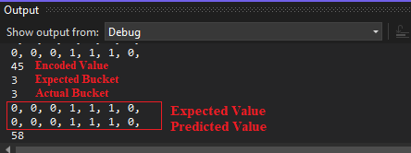
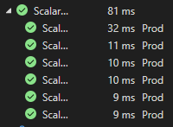
Output & Result
For Value =45, W=3, N=7, MinVal=0, MaxVal =59 , Periodic =False , ClipInput = True
Expected Bucket perfectly matched with Actual Bucket
Expected SDR perfectly matched with Actual SDR
Test Passed.

Slide 20
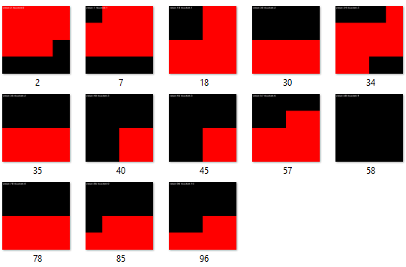
Output & Result
Bitmaps for all DataRows after setting all the parameter values and executing the Unit Test.

Slide 21
Unit Tests V Scalar Encoder With Bucket Temperature Ranges
public void ScalarEncoderWithTemperatureRanges(double input, double bucket, int[] expectedResult)
{
string outFolder = nameof(ScalarEncodingExperiment);
Directory.CreateDirectory(outFolder);
DateTime now = DateTime.Now;
ScalarEncoder encoder = new ScalarEncoder(new Dictionary<string, object>()
{
{ "W", 11},
{ "N", 20},
{ "MinVal", (double)-10}, // Min value = (-10).
{ "MaxVal", (double)100}, // Max value = (100).
{ "Periodic", false},
{ "Name", " Month of the Year"},
{ "ClipInput", true},
});
{ var result = encoder.Encode(input);
int? bucketIndex = encoder.GetBucketIndex(input);
int[,] twoDimenArray = ArrayUtils.Make2DArray<int>(result, (int)Math.Sqrt(result.Length),
(int)Math.Sqrt(result.Length));
var twoDimArray = ArrayUtils.Transpose(twoDimenArray);

Slide 22
Unit Tests IV Scalar Encoder With Bucket Age Categories
Input Data Row
[DataRow(-9.0, -5.0, new int[] { 1, 1, 1, 1, 1, 1, 0, 0, 0, 0, 0, 0, 0, 0, 0, 1, 1, 1, 1, 1, })]
[DataRow(-2.0, -4.0, new int[] { 1, 1, 1, 1, 1, 1, 1, 0, 0, 0, 0, 0, 0, 0, 0, 0, 1, 1, 1, 1, })]
[DataRow(8.0, -2.0, new int[] { 1, 1, 1, 1, 1, 1, 1, 1, 1, 0, 0, 0, 0, 0, 0, 0, 0, 0, 1, 1, })]
[DataRow(31.0, 2.0, new int[] { 0, 0, 1, 1, 1, 1, 1, 1, 1, 1, 1, 1, 1, 0, 0, 0, 0, 0, 0, 0, })]
[DataRow(57.0, 7.0, new int[] { 0, 0, 0, 0, 0, 0, 0, 1, 1, 1, 1, 1, 1, 1, 1, 1, 1, 1, 0, 0, })]
[DataRow(73.0, 10.0, new int[] { 1, 0, 0, 0, 0, 0, 0, 0, 0, 0, 1, 1, 1, 1, 1, 1, 1, 1, 1, 1, })]
[DataRow(81.0, 11.0, new int[] { 1, 1, 0, 0, 0, 0, 0, 0, 0, 0, 0, 1, 1, 1, 1, 1, 1, 1, 1, 1, })]
[DataRow(93.0, 13.0, new int[] { 1, 1, 1, 1, 0, 0, 0, 0, 0, 0, 0, 0, 0, 1, 1, 1, 1, 1, 1, 1, })]
[DataRow(98.0, 14.0, new int[] { 1, 1, 1, 1, 1, 0, 0, 0, 0, 0, 0, 0, 0, 0, 1, 1, 1, 1, 1, 1, })]

Slide 23
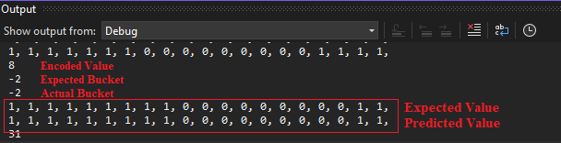
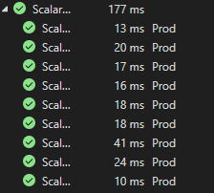
Output & Result
For Value =8, W=11, N=20, MinVal=0, MaxVal =100 , Periodic =True , ClipInput = True
Expected Bucket perfectly matched with Actual Bucket
Expected SDR perfectly matched with Actual SDR
Test Passed.

Slide 24
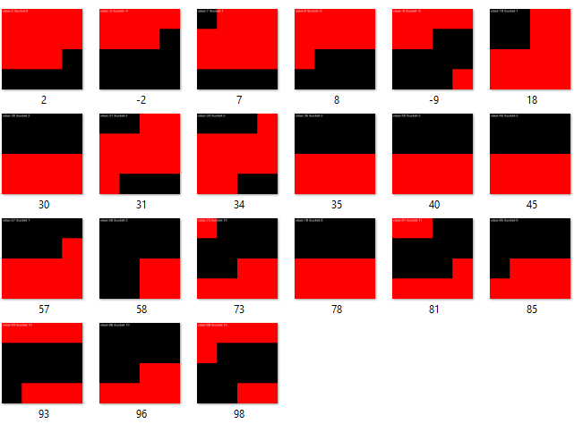
Output & Result
Bitmaps for all DataRows after setting all the parameter values and executing the Unit Test.

Slide 25
Unit Tests VI Basic Unit Test For Scalar Encoder With Bucket(Non-Periodic)
public void ScalarEncoderWithBucketBasicUnitTest(double input, int bucket, int[] expectedResult)
{string outFolder = nameof(ScalarEncoderWithBucketBasicUnitTest);
Directory.CreateDirectory(outFolder);
DateTime now = DateTime.Now;
ScalarEncoder encoder = new ScalarEncoder(new Dictionary<string, object>()
{
{ "W", 5},
{ "N", 20},
{ "MinVal", (double)0}, // Min value = 0
{ "MaxVal", (double)20}, // Max value
{ "Periodic", false },
{ "Name", "Basic"},
{ "ClipInput", false}, });
var result = encoder.Encode(input);
int? bucketIndex = encoder.GetBucketIndex(input);
int[,] twoDimenArray = ArrayUtils.Make2DArray<int>(result, (int)Math.Sqrt(result.Length), (int)Math.Sqrt(result.Length));
var twoDimArray = ArrayUtils.Transpose(twoDimenArray);
// NeoCortexUtils.DrawBitmap(twoDimArray, 1024, 1024, $"{outFolder}\\{input}.png", Color.Black, Color.Red, text:

Slide 26
Unit Tests VI Basic Unit Test For Scalar Encoder With Bucket(Non-Periodic)
INPUT DATA ROW
[DataRow(9, 7, new int[] { 0, 0, 0, 0, 0, 0, 0, 1, 1, 1, 1, 1, 0, 0, 0, 0, 0, 0, 0, 0, })]
[DataRow(10, 8, new int[] { 0, 0, 0, 0, 0, 0, 0, 0, 1, 1, 1, 1, 1, 0, 0, 0, 0, 0, 0, 0, })]
[DataRow(11, 8, new int[] { 0, 0, 0, 0, 0, 0, 0, 0, 1, 1, 1, 1, 1, 0, 0, 0, 0, 0, 0, 0, })]
[DataRow(12, 9, new int[] { 0, 0, 0, 0, 0, 0, 0, 0, 0, 1, 1, 1, 1, 1, 0, 0, 0, 0, 0, 0, })]
[DataRow(13, 10, new int[] { 0, 0, 0, 0, 0, 0, 0, 0, 0, 0, 1, 1, 1, 1, 1, 0, 0, 0, 0, 0, })]
[DataRow(14, 11, new int[] { 0, 0, 0, 0, 0, 0, 0, 0, 0, 0, 0, 1, 1, 1, 1, 1, 0, 0, 0, 0, })]
[DataRow(15, 11, new int[] { 0, 0, 0, 0, 0, 0, 0, 0, 0, 0, 0, 1, 1, 1, 1, 1, 0, 0, 0, 0, })]
[DataRow(16, 12, new int[] { 0, 0, 0, 0, 0, 0, 0, 0, 0, 0, 0, 0, 1, 1, 1, 1, 1, 0, 0, 0, })]
[DataRow(17, 13, new int[] { 0, 0, 0, 0, 0, 0, 0, 0, 0, 0, 0, 0, 0, 1, 1, 1, 1, 1, 0, 0, })]
[DataRow(18, 14, new int[] { 0, 0, 0, 0, 0, 0, 0, 0, 0, 0, 0, 0, 0, 0, 1, 1, 1, 1, 1, 0, })]
[DataRow(19, 14, new int[] { 0, 0, 0, 0, 0, 0, 0, 0, 0, 0, 0, 0, 0, 0, 1, 1, 1, 1, 1, 0, })]
[DataRow(20, 15, new int[] { 0, 0, 0, 0, 0, 0, 0, 0, 0, 0, 0, 0, 0, 0, 0, 1, 1, 1, 1, 1, })]

Slide 27

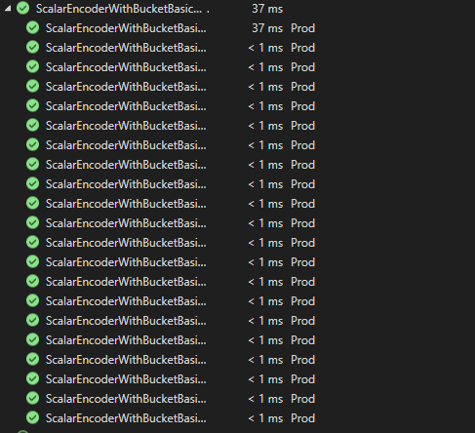
Output & Results
For Value = 15 W= 5, N= 20 , MinVal = 0 , MaxVal =20 , Periodic = False , Clipped Input = False
Expected Bucket Value = Actual Bucket Value
Expected SDR = Actual SDR
ALL Test Passed

Slide 28
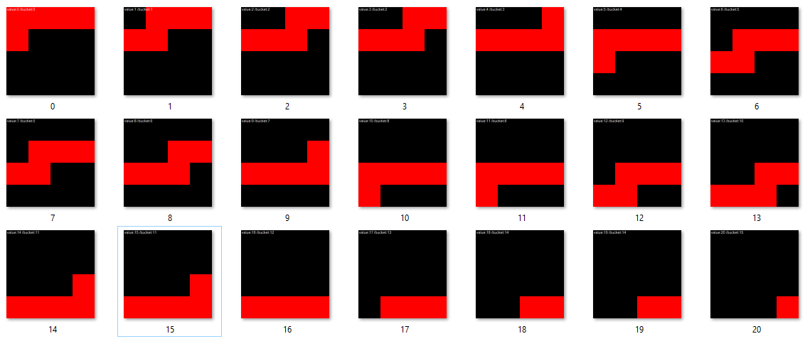
Output & Result
Bitmap for all DataRows after setting all the Parameter values and executing the Unit Test

Slide 29
Unit Tests VII Negative Values Test For Scalar Encoder With Bucket
public void ScalarEncoderWithBucketBasicUnitTest(double input, int bucket, int[] expectedResult)
{string outFolder = nameof(ScalarEncoderWithBucketBasicUnitTest);
Directory.CreateDirectory(outFolder);
DateTime now = DateTime.Now;
ScalarEncoder encoder = new ScalarEncoder(new Dictionary<string, object>()
{
{ "W", 5},
{ "N", 15},
{ "MinVal", (double)-20}, // Min value = -20
{ "MaxVal", (double)-1}, // Max value -1
{ "Periodic", false },
{ "Name", "Basic"},
{ "ClipInput", false}, });
var result = encoder.Encode(input);
int? bucketIndex = encoder.GetBucketIndex(input);
int[,] twoDimenArray = ArrayUtils.Make2DArray<int>(result, (int)Math.Sqrt(result.Length), (int)Math.Sqrt(result.Length));
var twoDimArray = ArrayUtils.Transpose(twoDimenArray);
// NeoCortexUtils.DrawBitmap(twoDimArray, 1024, 1024, $"{outFolder}\\{input}.png", Color.Black, Color.Red, text:

Slide 30
Unit Tests VII Negative Values Test For Scalar Encoder With Bucket
INPUT DATA ROW
[DataRow(-20, 0, new int[] { 1, 1, 1, 1, 1, 0, 0, 0, 0, 0, 0, 0, 0, 0, 0, })]
[DataRow(-19, 1, new int[] { 0, 1, 1, 1, 1, 1, 0, 0, 0, 0, 0, 0, 0, 0, 0, })]
[DataRow(-18, 1, new int[] { 0, 1, 1, 1, 1, 1, 0, 0, 0, 0, 0, 0, 0, 0, 0, })]
[DataRow(-17, 2, new int[] { 0, 0, 1, 1, 1, 1, 1, 0, 0, 0, 0, 0, 0, 0, 0, })]
[DataRow(-16, 2, new int[] { 0, 0, 1, 1, 1, 1, 1, 0, 0, 0, 0, 0, 0, 0, 0, })]
[DataRow(-15, 3, new int[] { 0, 0, 0, 1, 1, 1, 1, 1, 0, 0, 0, 0, 0, 0, 0, })]
[DataRow(-14, 3, new int[] { 0, 0, 0, 1, 1, 1, 1, 1, 0, 0, 0, 0, 0, 0, 0, })]
[DataRow(-13, 4, new int[] { 0, 0, 0, 0, 1, 1, 1, 1, 1, 0, 0, 0, 0, 0, 0, })]
[DataRow(-12, 4, new int[] { 0, 0, 0, 0, 1, 1, 1, 1, 1, 0, 0, 0, 0, 0, 0, })]
[DataRow(-12, 4, new int[] { 0, 0, 0, 0, 1, 1, 1, 1, 1, 0, 0, 0, 0, 0, 0, })]
[DataRow(-11, 5, new int[] { 0, 0, 0, 0, 0, 1, 1, 1, 1, 1, 0, 0, 0, 0, 0, })]

Slide 31

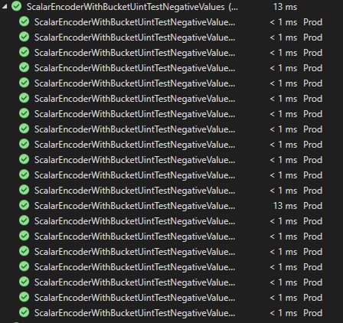
Output & Results
For value = -20 W= 5, N= 15 , MinVal = -20, MaxVal = -1 , Periodic = False , ClipInput = False
Expected Bucket Value = Actual Bucket Value
Expected SDR = Actual SDR
ALL Test Passed

Slide 32
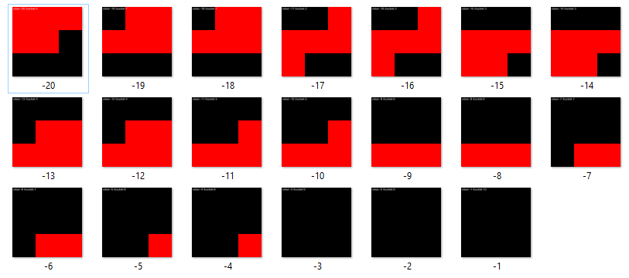
Output & Result
Bitmap for all DataRows after setting all the Parameter values and executing the Unit Test

Slide 33
Unit Tests VIII Decimal Values Test For Scalar Encoder With Buckets
public void ScalarEncoderWithBucketBasicUnitTest(double input, int bucket, int[] expectedResult)
{string outFolder = nameof(ScalarEncoderWithBucketBasicUnitTest);
Directory.CreateDirectory(outFolder);
DateTime now = DateTime.Now;
ScalarEncoder encoder = new ScalarEncoder(new Dictionary<string, object>()
{
{ "W", 7},
{ "N", 25},
{ "MinVal", (double)0}, // Min value = (0).
{ "MaxVal", (double)1}, // Max value = (1).
{ "Periodic", false },
{ "Name", "Basic"},
{ "ClipInput", false},
});
var result = encoder.Encode(input);
int? bucketIndex = encoder.GetBucketIndex(input);
int[,] twoDimenArray = ArrayUtils.Make2DArray<int>(result, (int)Math.Sqrt(result.Length), (int)Math.Sqrt(result.Length));
var twoDimArray = ArrayUtils.Transpose(twoDimenArray);
// NeoCortexUtils.DrawBitmap(twoDimArray, 1024, 1024, $"{outFolder}\\{input}.png", Color.Black, Color.Red, text:

Slide 34
Unit Tests VIII Decimal Values Test For Scalar Encoder With Buckets
INPUT DATA ROW
[DataRow(0.0, 0, new int[] { 1, 1, 1, 1, 1, 1, 1, 0, 0, 0, 0, 0, 0, 0, 0, 0, 0, 0, 0, 0, 0, 0, 0, 0, 0, })]
[DataRow(0.1, 2, new int[] { 0, 0, 1, 1, 1, 1, 1, 1, 1, 0, 0, 0, 0, 0, 0, 0, 0, 0, 0, 0, 0, 0, 0, 0, 0, })]
[DataRow(0.2, 4, new int[] { 0, 0, 0, 0, 1, 1, 1, 1, 1, 1, 1, 0, 0, 0, 0, 0, 0, 0, 0, 0, 0, 0, 0, 0, 0, })]
[DataRow(0.3, 5, new int[] { 0, 0, 0, 0, 0, 1, 1, 1, 1, 1, 1, 1, 0, 0, 0, 0, 0, 0, 0, 0, 0, 0, 0, 0, 0, })]
[DataRow(0.4, 7, new int[] { 0, 0, 0, 0, 0, 0, 0, 1, 1, 1, 1, 1, 1, 1, 0, 0, 0, 0, 0, 0, 0, 0, 0, 0, 0, })]
[DataRow(0.5, 9, new int[] { 0, 0, 0, 0, 0, 0, 0, 0, 0, 1, 1, 1, 1, 1, 1, 1, 0, 0, 0, 0, 0, 0, 0, 0, 0, })]
[DataRow(0.6, 11, new int[] { 0, 0, 0, 0, 0, 0, 0, 0, 0, 0, 0, 1, 1, 1, 1, 1, 1, 1, 0, 0, 0, 0, 0, 0, 0, })]
[DataRow(0.7, 13, new int[] { 0, 0, 0, 0, 0, 0, 0, 0, 0, 0, 0, 0, 0, 1, 1, 1, 1, 1, 1, 1, 0, 0, 0, 0, 0, })]
[DataRow(0.8, 14, new int[] { 0, 0, 0, 0, 0, 0, 0, 0, 0, 0, 0, 0, 0, 0, 1, 1, 1, 1, 1, 1, 1, 0, 0, 0, 0, })]
[DataRow(0.9, 16, new int[] { 0, 0, 0, 0, 0, 0, 0, 0, 0, 0, 0, 0, 0, 0, 0, 0, 1, 1, 1, 1, 1, 1, 1, 0, 0, })]
[DataRow(1.0, 18, new int[] { 0, 0, 0, 0, 0, 0, 0, 0, 0, 0, 0, 0, 0, 0, 0, 0, 0, 0, 1, 1, 1, 1, 1, 1, 1, })]

Slide 35

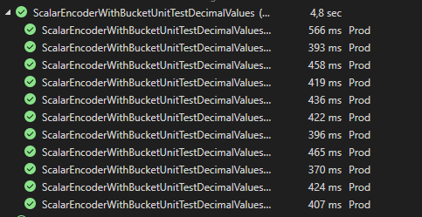
Output & Results
For value = 0.3 W= 7, N= 25 , MinVal = 0, MaxVal = 1 , Periodic = False , ClipInput = False
Expected Bucket Value = Actual Bucket Value
Expected SDR = Actual SDR
ALL Test Passed

Slide 36
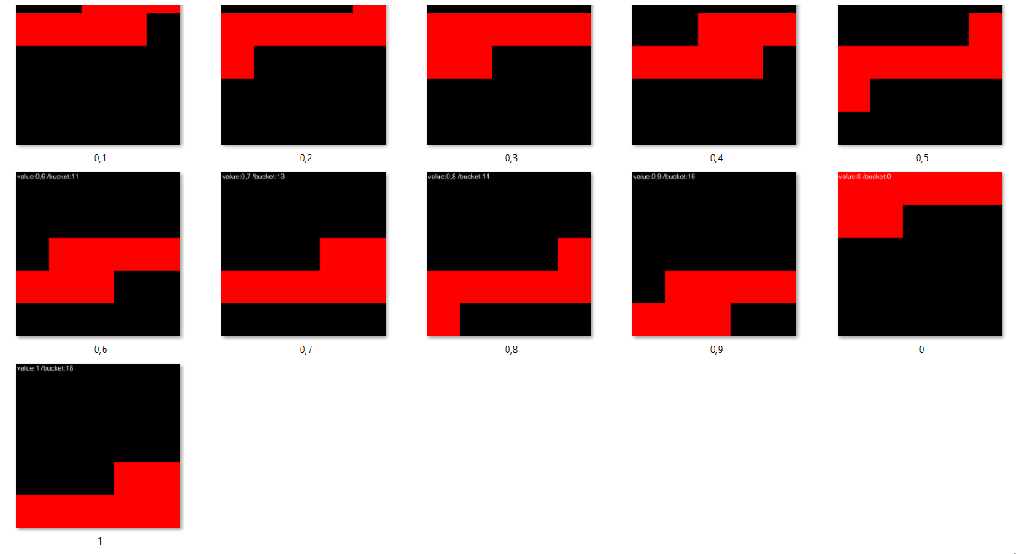
Output & Result
Bitmap for all DataRows after setting all the Parameter values and executing the Unit Test

Slide 37
Unit Tests IX Radius Test For Scalar Encoder With Buckets
public void ScalarEncoderWithBucketBasicUnitTest(double input, int bucket, int[] expectedResult)
{string outFolder = nameof(ScalarEncoderWithBucketBasicUnitTest);
Directory.CreateDirectory(outFolder);
DateTime now = DateTime.Now;
ScalarEncoder encoder = new ScalarEncoder(new Dictionary<string, object>()
{
{ "W", 5},
{ "Radius", 3.75}, // Now Radius instead of "N"
{ "MinVal", (double)0}, // Min value = (0).
{ "MaxVal", (double)15}, // Max value = (15).
{ "Periodic", false },
{ "Name", "Basic"},
{ "ClipInput", false}, });
var result = encoder.Encode(input);
int? bucketIndex = encoder.GetBucketIndex(input);
int[,] twoDimenArray = ArrayUtils.Make2DArray<int>(result, (int)Math.Sqrt(result.Length), (int)Math.Sqrt(result.Length));
var twoDimArray = ArrayUtils.Transpose(twoDimenArray);
// NeoCortexUtils.DrawBitmap(twoDimArray, 1024, 1024, $"{outFolder}\\{input}.png", Color.Black, Color.Red, text:

Slide 38
Unit Tests VIII Decimal Values Test For Scalar Encoder With Buckets
INPUT DATA ROW
[DataRow(0, 0, new int[] { 1, 1, 1, 1, 1, 0, 0, 0, 0, 0, 0, 0, 0, 0, 0, 0, 0, 0, 0, 0, 0, 0, 0, 0, 0, })]
[DataRow(1, 1, new int[] { 0, 1, 1, 1, 1, 1, 0, 0, 0, 0, 0, 0, 0, 0, 0, 0, 0, 0, 0, 0, 0, 0, 0, 0, 0, })]
[DataRow(2, 3, new int[] { 0, 0, 0, 1, 1, 1, 1, 1, 0, 0, 0, 0, 0, 0, 0, 0, 0, 0, 0, 0, 0, 0, 0, 0, 0, })]
[DataRow(3, 4, new int[] { 0, 0, 0, 0, 1, 1, 1, 1, 1, 0, 0, 0, 0, 0, 0, 0, 0, 0, 0, 0, 0, 0, 0, 0, 0, })]
[DataRow(4, 5, new int[] { 0, 0, 0, 0, 0, 1, 1, 1, 1, 1, 0, 0, 0, 0, 0, 0, 0, 0, 0, 0, 0, 0, 0, 0, 0, })]
[DataRow(5, 7, new int[] { 0, 0, 0, 0, 0, 0, 0, 1, 1, 1, 1, 1, 0, 0, 0, 0, 0, 0, 0, 0, 0, 0, 0, 0, 0, })]
[DataRow(6, 8, new int[] { 0, 0, 0, 0, 0, 0, 0, 0, 1, 1, 1, 1, 1, 0, 0, 0, 0, 0, 0, 0, 0, 0, 0, 0, 0, })]
[DataRow(7, 9, new int[] { 0, 0, 0, 0, 0, 0, 0, 0, 0, 1, 1, 1, 1, 1, 0, 0, 0, 0, 0, 0, 0, 0, 0, 0, 0, })]
[DataRow(8, 11, new int[] { 0, 0, 0, 0, 0, 0, 0, 0, 0, 0, 0, 1, 1, 1, 1, 1, 0, 0, 0, 0, 0, 0, 0, 0, 0, })]
[DataRow(9, 12, new int[] { 0, 0, 0, 0, 0, 0, 0, 0, 0, 0, 0, 0, 1, 1, 1, 1, 1, 0, 0, 0, 0, 0, 0, 0, 0, })]
[DataRow(10, 13, new int[] { 0, 0, 0, 0, 0, 0, 0, 0, 0, 0, 0, 0, 0, 1, 1, 1, 1, 1, 0, 0, 0, 0, 0, 0, 0, })]

Slide 39

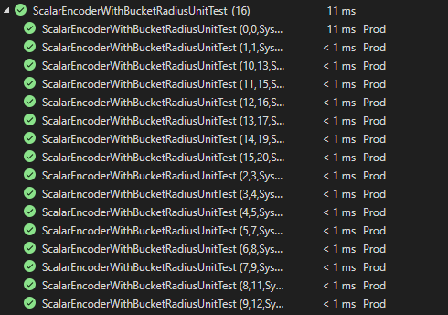
Output & Results
For value = 6, Radius = 3.75 W= 5, MinVal = 0, MaxVal = 15 , Periodic = False , ClipInput = False
Expected Bucket Value = Actual Bucket Value
Expected SDR = Actual SDR
ALL Test Passed

Slide 40
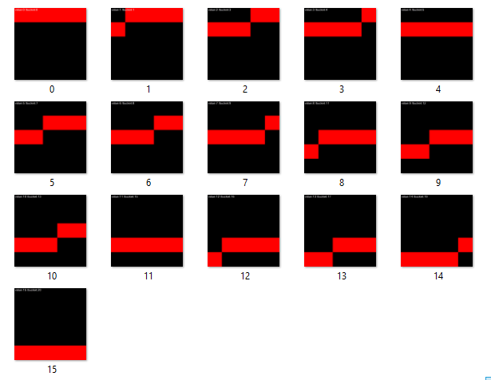
Output & Result
Bitmap for all DataRows after setting all the Parameter values and executing the Unit Test

Slide 41
Unit Tests X ClipInput Test For Scalar Encoder With Buckets
public void ScalarEncoderWithBucketBasicUnitTest(double input, int bucket, int[] expectedResult)
{string outFolder = nameof(ScalarEncoderWithBucketBasicUnitTest);
Directory.CreateDirectory(outFolder);
DateTime now = DateTime.Now;
ScalarEncoder encoder = new ScalarEncoder(new Dictionary<string, object>()
{
{ "W", 5},
{ "N", 20},
{ "MinVal", (double)0}, // Min value = (0).
{ "MaxVal", (double)20}, // Max value = (20).
{ "Periodic", false },
{ "Name", "Basic"},
{ "ClipInput", true}, //For Clipping values outside the range});
var result = encoder.Encode(input);
int? bucketIndex = encoder.GetBucketIndex(input);
int[,] twoDimenArray = ArrayUtils.Make2DArray<int>(result, (int)Math.Sqrt(result.Length), (int)Math.Sqrt(result.Length));
var twoDimArray = ArrayUtils.Transpose(twoDimenArray);
// NeoCortexUtils.DrawBitmap(twoDimArray, 1024, 1024, $"{outFolder}\\{input}.png", Color.Black, Color.Red, text:

Slide 42
Unit Tests X ClipInput Test For Scalar Encoder With Buckets
INPUT DATA ROW
[DataRow(0, 0, new int[] { 1, 1, 1, 1, 1, 0, 0, 0, 0, 0, 0, 0, 0, 0, 0, 0, 0, 0, 0, 0, })]
[DataRow(-100, 0, new int[] { 1, 1, 1, 1, 1, 0, 0, 0, 0, 0, 0, 0, 0, 0, 0, 0, 0, 0, 0, 0, })]
[DataRow(200, 15, new int[] { 0, 0, 0, 0, 0, 0, 0, 0, 0, 0, 0, 0, 0, 0, 0, 1, 1, 1, 1, 1, })]
[DataRow(35, 15, new int[] { 0, 0, 0, 0, 0, 0, 0, 0, 0, 0, 0, 0, 0, 0, 0, 1, 1, 1, 1, 1, })]
[DataRow(-100, 0, new int[] { 1, 1, 1, 1, 1, 0, 0, 0, 0, 0, 0, 0, 0, 0, 0, 0, 0, 0, 0, 0, })]
[DataRow(-2500, 0, new int[] { 1, 1, 1, 1, 1, 0, 0, 0, 0, 0, 0, 0, 0, 0, 0, 0, 0, 0, 0, 0, })]
[DataRow(3500, 15, new int[] { 0, 0, 0, 0, 0, 0, 0, 0, 0, 0, 0, 0, 0, 0, 0, 1, 1, 1, 1, 1, })]
[DataRow(20.5, 15, new int[] { 0, 0, 0, 0, 0, 0, 0, 0, 0, 0, 0, 0, 0, 0, 0, 1, 1, 1, 1, 1, })]
[DataRow(-0.5, 0, new int[] { 1, 1, 1, 1, 1, 0, 0, 0, 0, 0, 0, 0, 0, 0, 0, 0, 0, 0, 0, 0, })]

Slide 43

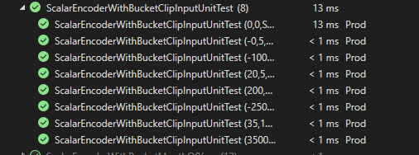
Output & Results
For value = 200, N= 20 W= 5, MinVal = 0, MaxVal = 20 , Periodic = False , ClipInput =True
Expected Bucket Value = Actual Bucket Value
Expected SDR = Actual SDR
ALL Test Passed

Slide 44
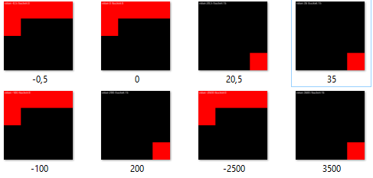
Output & Result
Bitmap for all DataRows after setting all the Parameter values and executing the Unit Test

Slide 45
Unit Tests XI Periodic Test For Scalar Encoder With Buckets
public void ScalarEncoderWithBucketBasicUnitTest(double input, int bucket, int[] expectedResult)
{string outFolder = nameof(ScalarEncoderWithBucketBasicUnitTest);
Directory.CreateDirectory(outFolder);
DateTime now = DateTime.Now;
ScalarEncoder encoder = new ScalarEncoder(new Dictionary<string, object>()
{
{ "W", 5},
{ "N", 20},
{ "MinVal", (double)0}, // Min value = (0).
{ "MaxVal", (double)20}, // Max value = (20).
{ "Periodic", true },
{ "Name", "Basic"},
{ "ClipInput", false},
}); var result = encoder.Encode(input);
int? bucketIndex = encoder.GetBucketIndex(input);
int[,] twoDimenArray = ArrayUtils.Make2DArray<int>(result, (int)Math.Sqrt(result.Length), (int)Math.Sqrt(result.Length));
var twoDimArray = ArrayUtils.Transpose(twoDimenArray);
// NeoCortexUtils.DrawBitmap(twoDimArray, 1024, 1024, $"{outFolder}\\{input}.png", Color.Black, Color.Red, text:

Slide 46
Unit Tests XI Periodic Test For Scalar Encoder With Buckets
INPUT DATA ROW
[DataRow(8, 6, new int[] { 0, 0, 0, 0, 0, 0, 1, 1, 1, 1, 1, 0, 0, 0, 0, 0, 0, 0, 0, 0, })]
[DataRow(9, 7, new int[] { 0, 0, 0, 0, 0, 0, 0, 1, 1, 1, 1, 1, 0, 0, 0, 0, 0, 0, 0, 0, })]
[DataRow(10, 8, new int[] { 0, 0, 0, 0, 0, 0, 0, 0, 1, 1, 1, 1, 1, 0, 0, 0, 0, 0, 0, 0, })]
[DataRow(11, 9, new int[] { 0, 0, 0, 0, 0, 0, 0, 0, 0, 1, 1, 1, 1, 1, 0, 0, 0, 0, 0, 0, })]
[DataRow(12, 10, new int[] { 0, 0, 0, 0, 0, 0, 0, 0, 0, 0, 1, 1, 1, 1, 1, 0, 0, 0, 0, 0, })]
[DataRow(13, 11, new int[] { 0, 0, 0, 0, 0, 0, 0, 0, 0, 0, 0, 1, 1, 1, 1, 1, 0, 0, 0, 0, })]
[DataRow(14, 12, new int[] { 0, 0, 0, 0, 0, 0, 0, 0, 0, 0, 0, 0, 1, 1, 1, 1, 1, 0, 0, 0, })]
[DataRow(15, 13, new int[] { 0, 0, 0, 0, 0, 0, 0, 0, 0, 0, 0, 0, 0, 1, 1, 1, 1, 1, 0, 0, })]
[DataRow(16, 14, new int[] { 0, 0, 0, 0, 0, 0, 0, 0, 0, 0, 0, 0, 0, 0, 1, 1, 1, 1, 1, 0, })]
[DataRow(17, 15, new int[] { 0, 0, 0, 0, 0, 0, 0, 0, 0, 0, 0, 0, 0, 0, 0, 1, 1, 1, 1, 1, })]
[DataRow(18, 16, new int[] { 1, 0, 0, 0, 0, 0, 0, 0, 0, 0, 0, 0, 0, 0, 0, 0, 1, 1, 1, 1, })]
[DataRow(19, 17, new int[] { 1, 1, 0, 0, 0, 0, 0, 0, 0, 0, 0, 0, 0, 0, 0, 0, 0, 1, 1, 1, })]

Slide 47

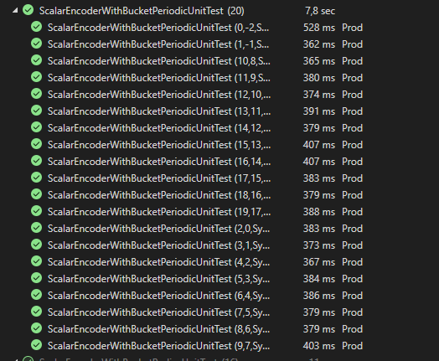
Output & Results
For value = 18, N= 20 W= 5, MinVal = 0, MaxVal = 20 , Periodic = False , ClipInput =True
Expected Bucket Value = Actual Bucket Value
Expected SDR = Actual SDR
ALL Test Passed

Slide 48
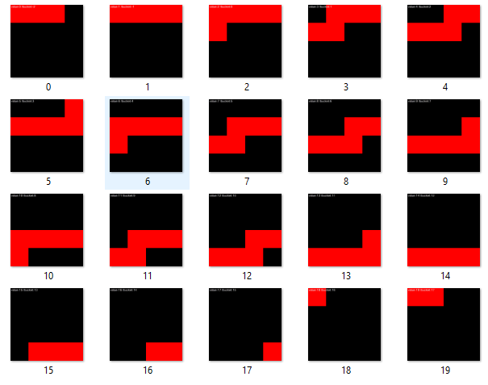
Output & Result
Bitmap for all DataRows after setting all the Parameter values and executing the Unit Test

Slide 49
Conclusion
Comprehensive Testing
Robustness to noise and varying degrees of sparsity
Encoding of Random Numerical Values
All Test Passed
Robustness to Negative Values , Decimal Values
Robustness to Periodicity, ClipInput Behavior

